Slide 1

COVID-19 DATADOC
Bhumika Punjabi- 001061256
Yash Thakkar- 001020277

Slide 2

ABOUT US
DataDoc offers the comprehensive virtual care solution capable of serving organizations and people anywhere. It seamlessly connects general medical, mental health, and complex care to deliver convenience, outcomes, and value. Our mission is to provide virtual care to the people with COVID-19 symptoms and provide them with proper medical care

Slide 3

Problem statement
Due to present pandemic situation, different parts of the country are seeing different levels of COVID-19 activity .In particular, “the low efficiency of medical system, the poor access and quality of medical services, the difficulty in providing efficiency of care and proper medical treatment as the main focus of social concern.
With this convection, the comprehensive virtual care solution capable of serving organizations and people anywhere .
DataDoc Bridges the Gap to provide virtual care to the people with COVID-19 symptoms and provide them with proper medical care. It seamlessly connects general medical, mental health, and complex care to deliver convenience, outcomes, and value.

Slide 4

Proposed Solution
COVID-19 DataDoc provides virtual health care management system. It connects the patient to the Medicare provider for COVID-19 related initial screening.
The patient can provide his/her required vitals using the DataDoc eco-system and this information is available to the Doctors within seconds to test the severity of the patient medical condition.
Based on the severity of the patient’s health, the doctor suggests with appropriate next steps such as medication, in-person screening, blood test etc.
In case of emergency, the hospitals shares the patient’s data to the emergency task force using the proposed system and can save lives.
DataDoc span the spectrum of healthcare needs, from simple to complex.

Slide 5





Approach
NGO
Doctors
Medical Lab
Emergency Services
HOSPITAL MANAGER
In DataDoc, NGO Connects the patients with the doctors virtually to provide healthcare and medication to the Covid-19 infected.
Doctors will add patient to a suspected list, if found any symptoms related to COVID-19 symptoms from patient Vital Sign.
Lab Organization Tests the severity of the patient’s health condition based on the tests.
In case of Abnormal Health condition the Emergency Services admin reach out to the Suspected Patient place, to bring them to the hospital.
Based on the Patients condition, Hospital sends email to the patient to remain Isolated. Hospital manager can also generate the data chart of the infected Patients.
Success

Slide 6
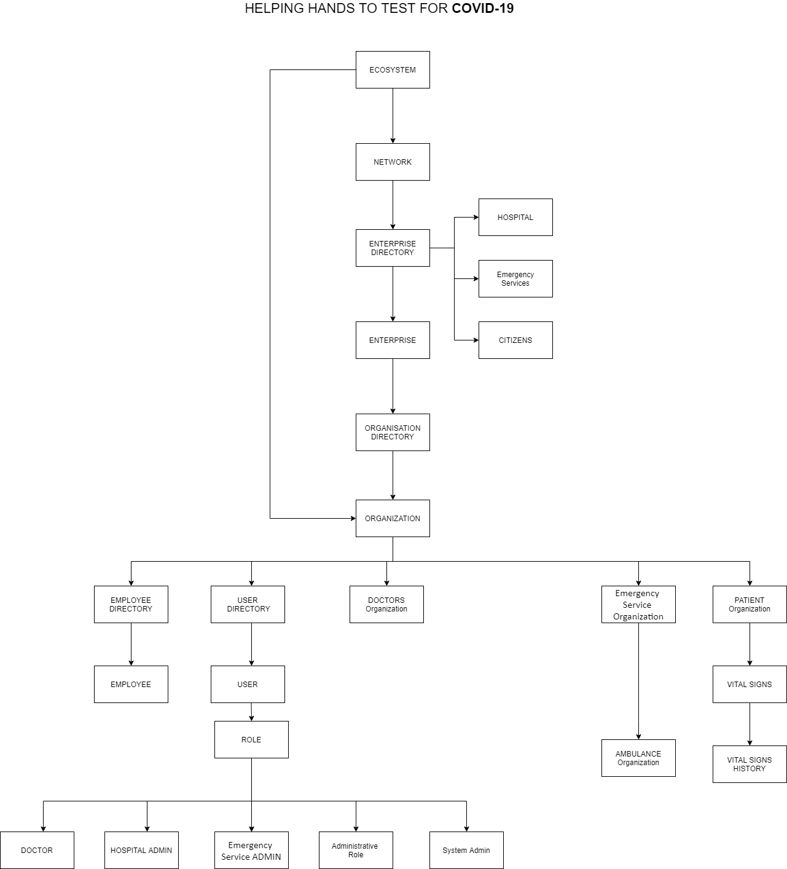
Object model

Slide 7
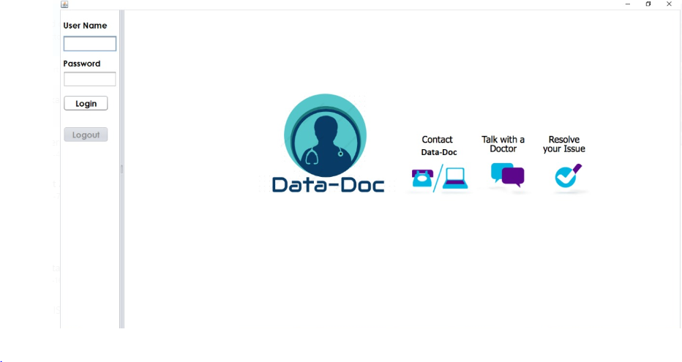
screenshot

Slide 8
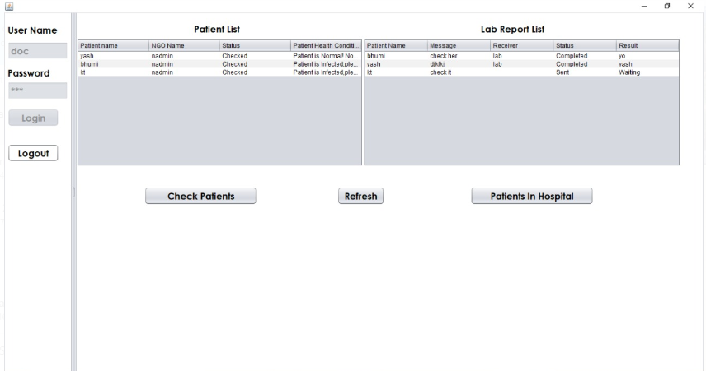
screenshot

Slide 9
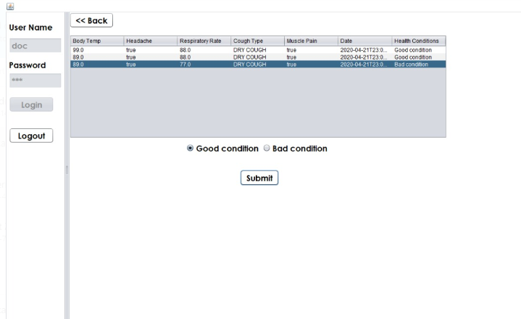
screenshot

Slide 10
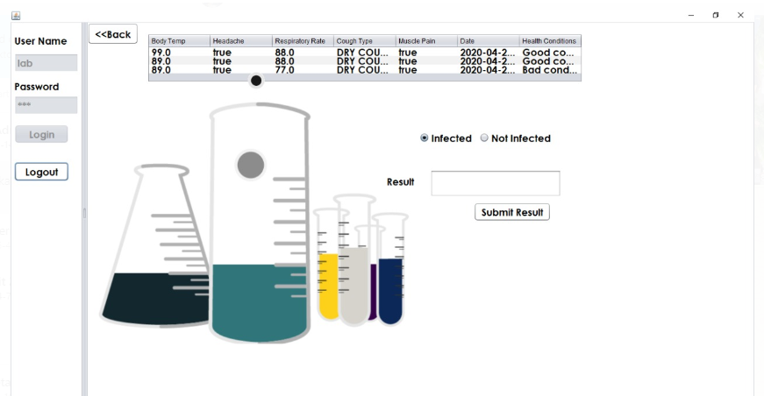
screenshot

Slide 11
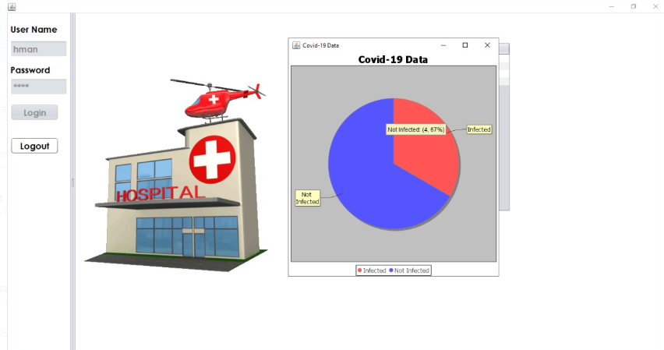
screenshot

Slide 12

Thank you NULL POINTERS()

